Slide 1
Assignment 8: High-Fi Prototype
Team kith&kin
Haven Whitney, Esi Donkor, Tenzin Dolkar

Slide 2
Problem
Parents face isolation and feel overwhelmed as they begin to raise children, leading to detrimental mental and physical health effects.

Slide 3
Solution
Provide parents greater access to in person community: guidance, empathy, and shared experience improves parent and child health.

Slide 4
Value Proposition
We help parents find community and resources by connecting them to local events and other parents.

Slide 5
Table of contents
Heuristic Evaluation
01
02
UI Revisions
Implementation Status
03
04
Prototype Demo

Slide 6
01
Heuristic Evaluation

Slide 7
Main Violation Categories
Consistency/Aesthetics
Clarity
Error Prevention
Visibility issues (ex. Distinguishing the background color, making buttons more clear)
Alignment/polish consistency
No visible system update with regards to screen change
Meaning of icons were unclear
Chat history did not display message timestamps
Event RSVP was final after a single-click with no confirmation or cancellation
Posts to a community board were public and permanent after a single click
Notes:
ALL VIOLATIONS LISTED IN THE APPENDIX – 89 total, but not all were unique

Slide 8
Additional Details on Violations
Description Rework
Text on Navbar
RSVP Modifications
Two severity 3 violations suggested that the event description and user profiles had too much text and to break them into separate sections.
A severity 3 violation mentioned it wasn’t clear what each icon did on the navigation bar and to add text under each (Recognition Rather than Recall).
A severity 3 violation requested more clarity on the event description page as to what “RSVP” meant and to add the ability to RSVP “Maybe” or “No” to an event.

Slide 9
02
UI Revisions

Slide 10
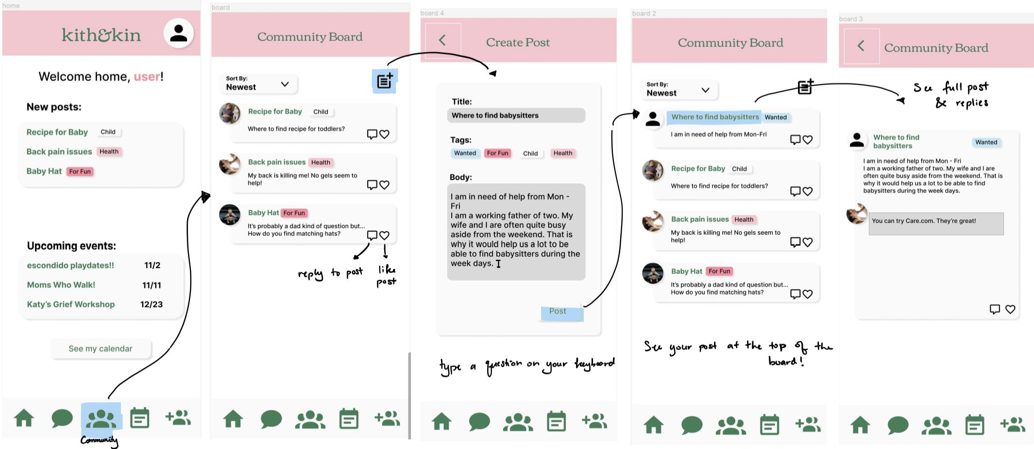
Ask a question on a community board - Before

Slide 11
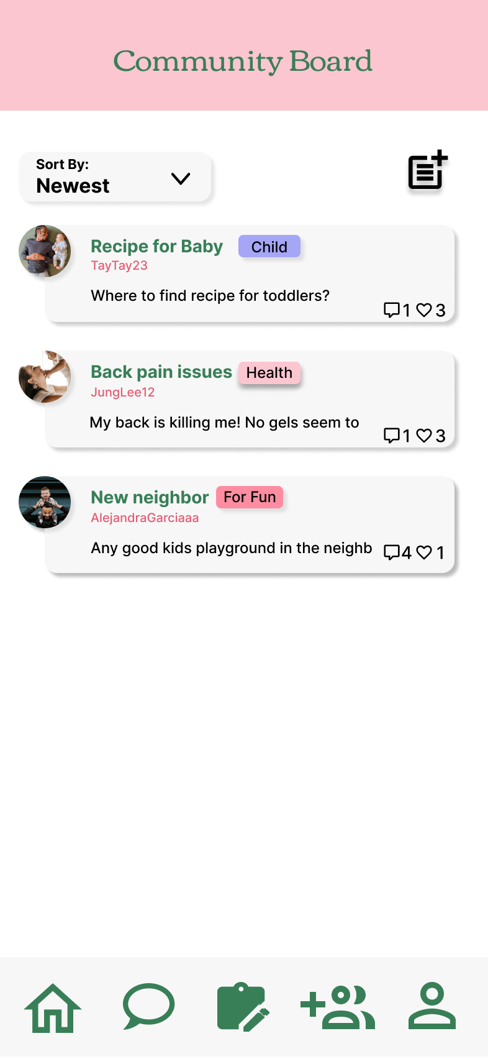
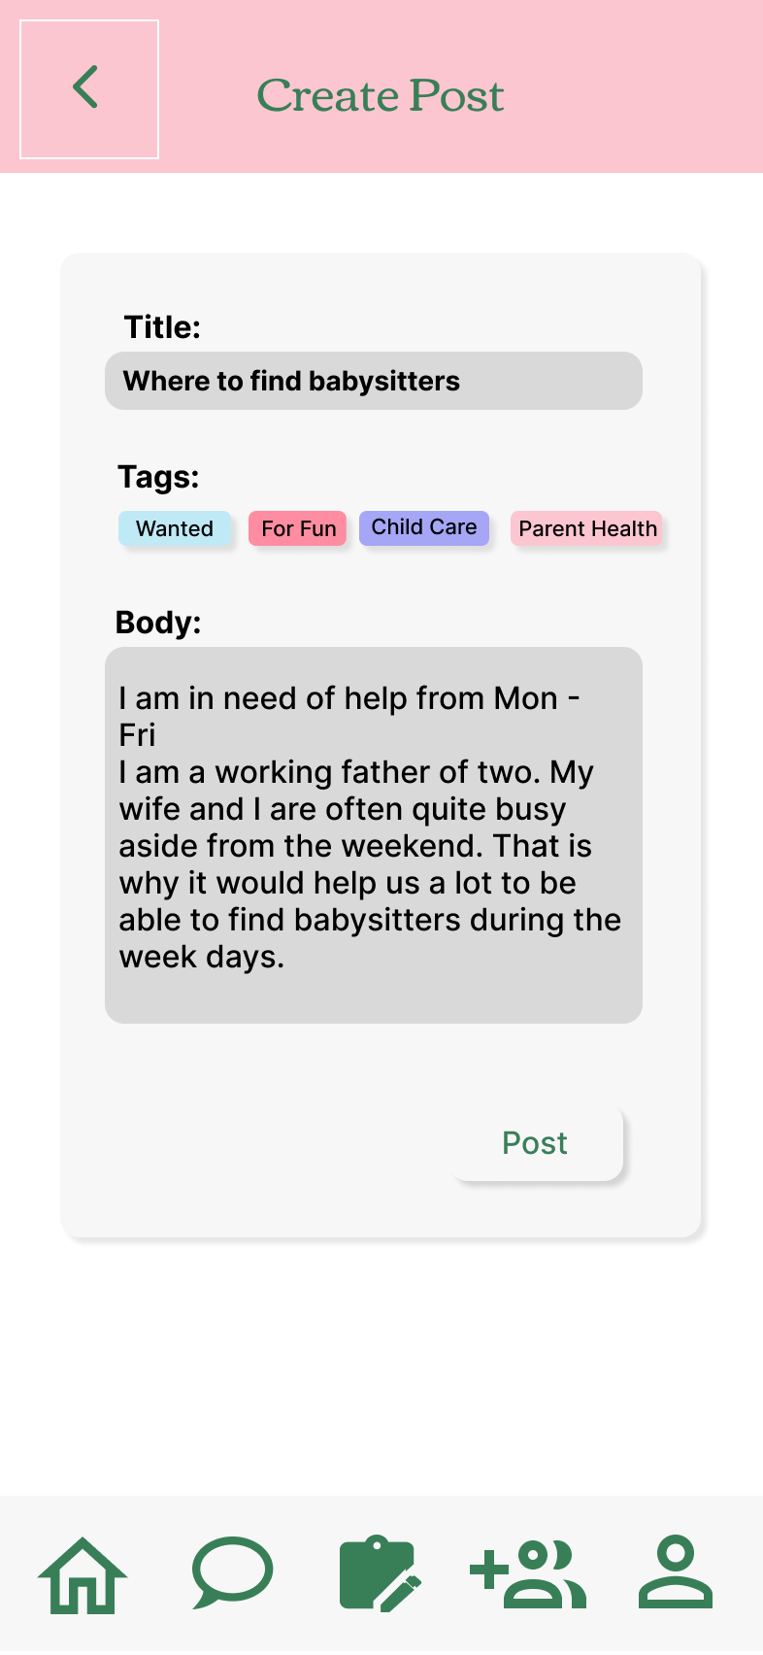
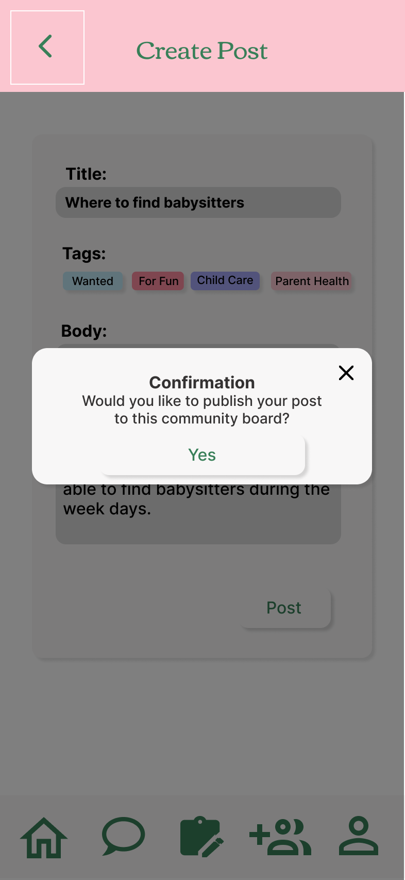
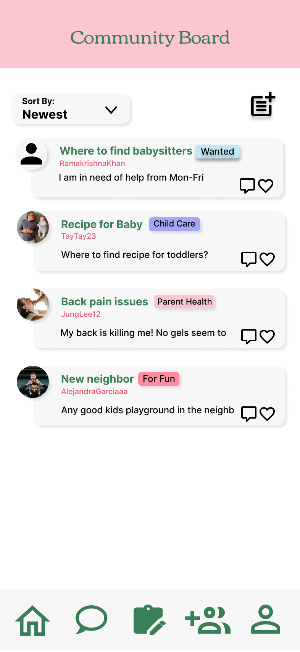
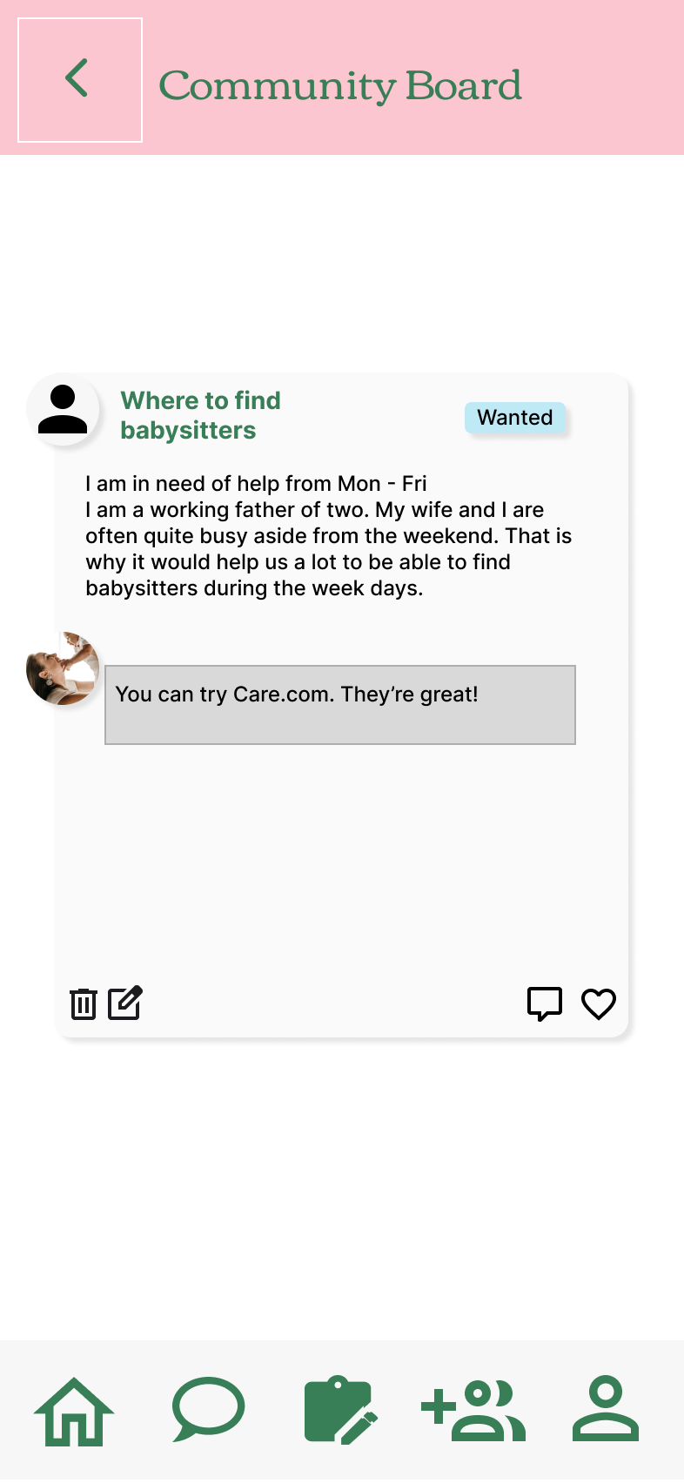
Ask a question on a community board – After

Slide 12
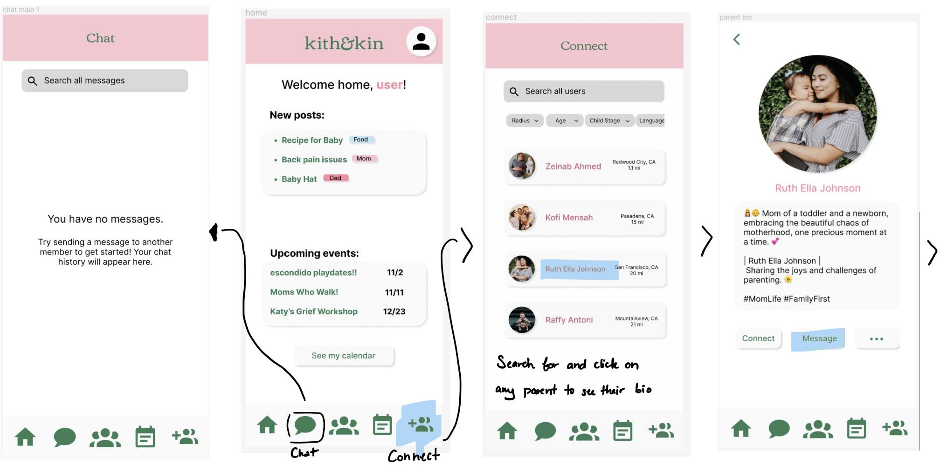
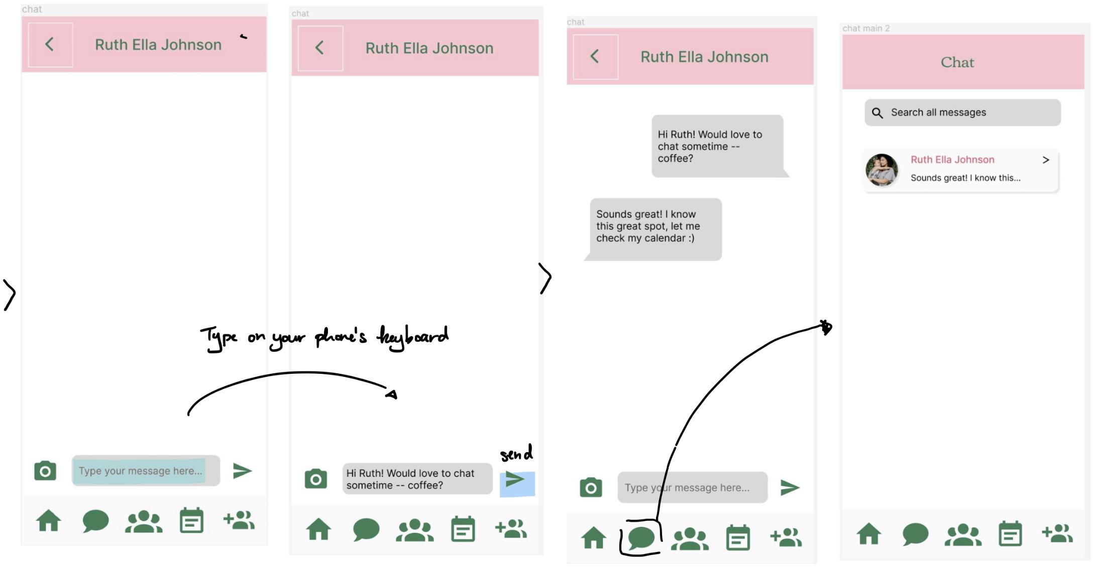
Find and connect with a parent by sending a DM – Before

Slide 13
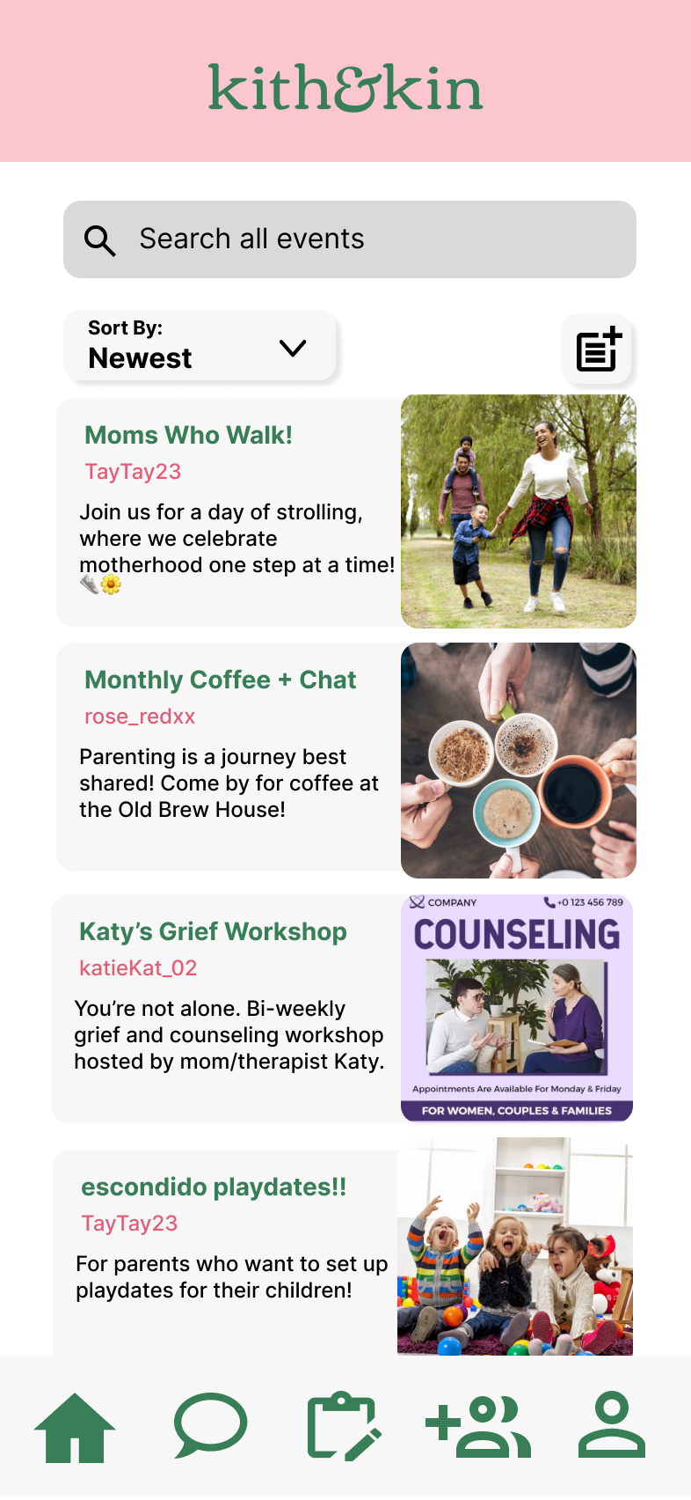
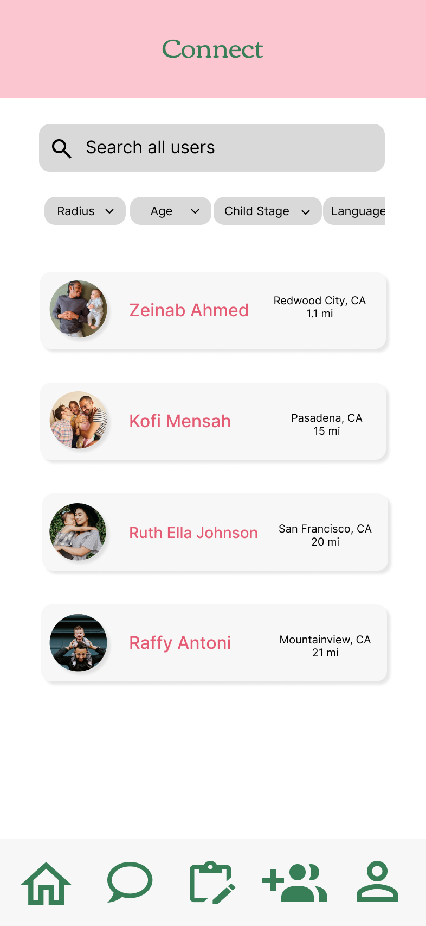
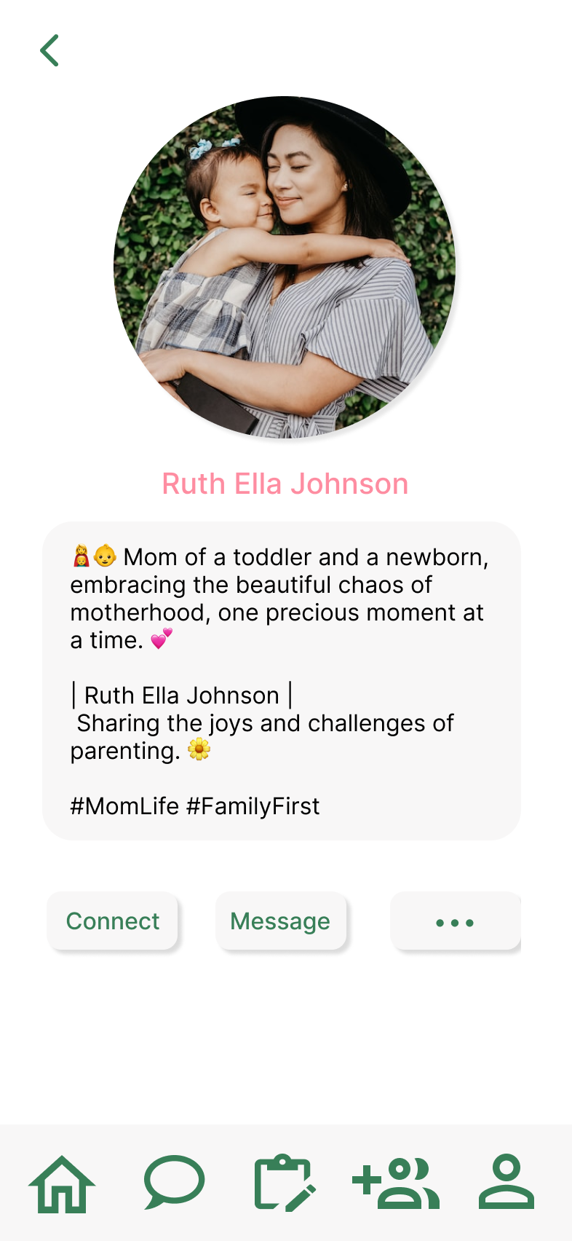
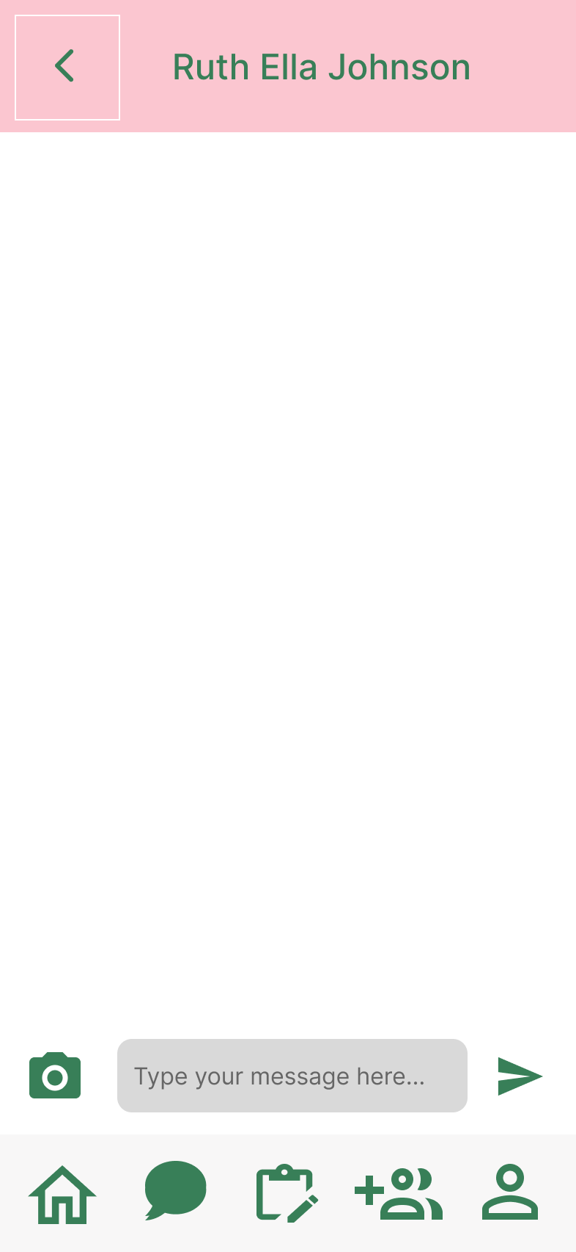
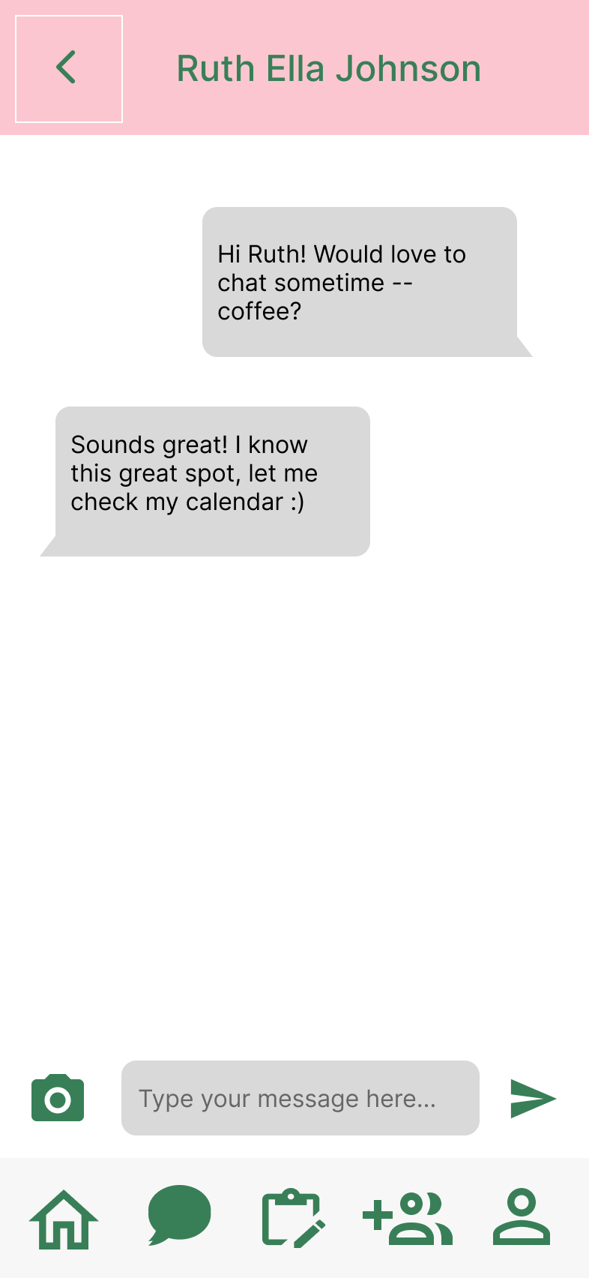
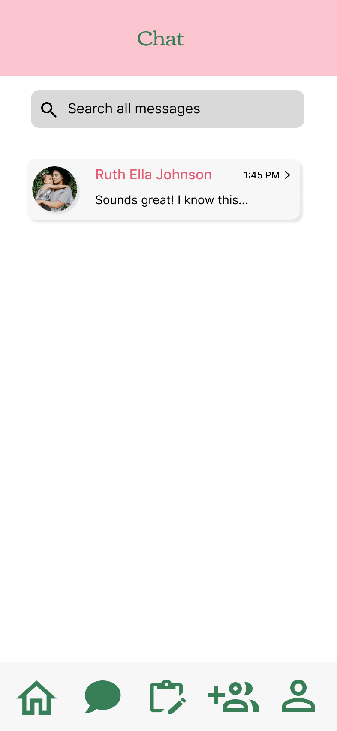
Find and connect with a parent by sending a DM – After

Slide 14
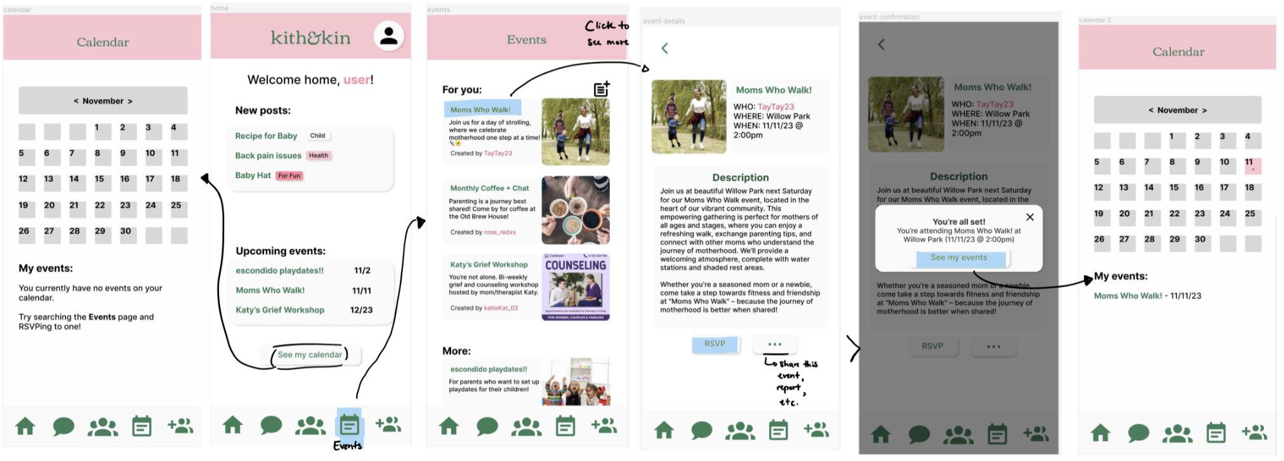
Search for and RSVP to an event nearby – Before

Slide 15
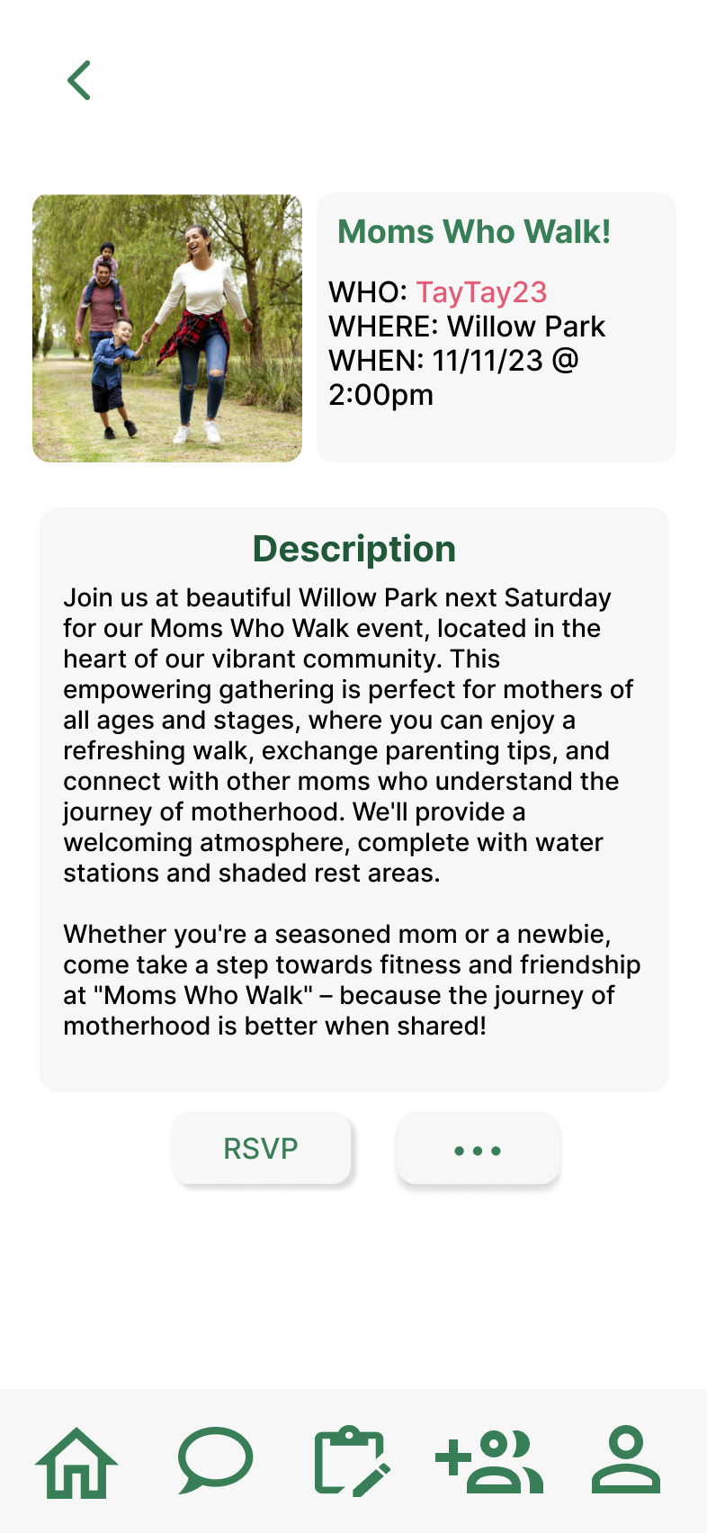
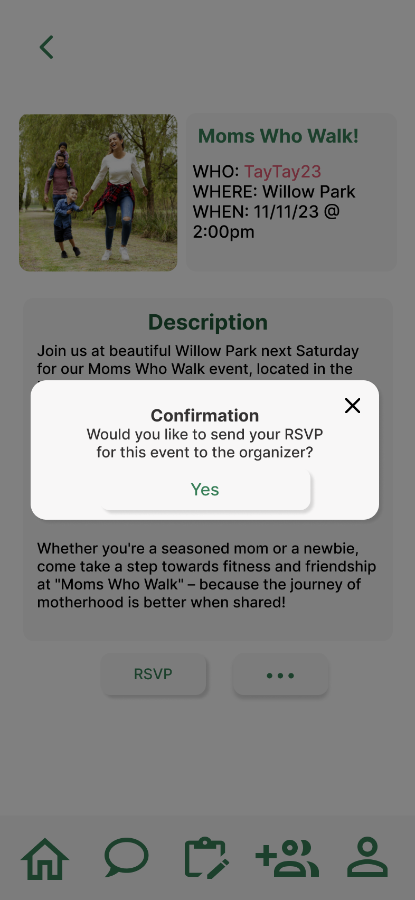
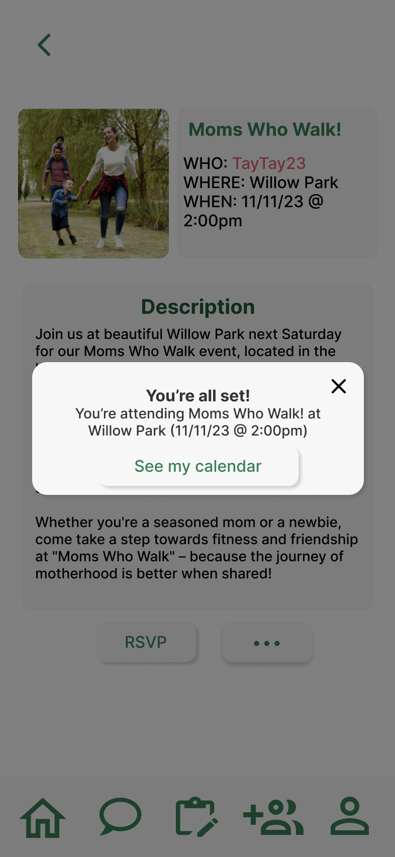
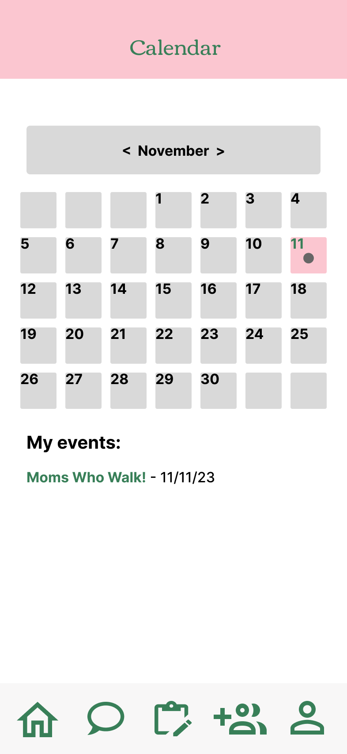
Search for and RSVP to an event nearby – After

Slide 16
Rationale
Addressing Violation Concerns
Consistency With Familiar Apps
We agreed with the majority of the violations found in our evaluation and wanted to rectify them, especially within the three main categories we identified.
Designing the app to be more consistent with other, well-used apps lessens the learning curve required to use ours, removing the barrier to entry.

Slide 17
Usability Progress
Easy to navigate
Customizable
Positive experience
Robust
Filter and search options allow users increasingly more ways to personalize their experience on the app
New navigation buttons and search bars allow greater ease of use
Aesthetic edits to white-on-white element colors and shadows under buttons make for a more pleasing app experience
Users are prompted by confirmation messages and able to edit and delete posts to minimize errors and allow for easier recovery.

Slide 18
03
Implementation Status

Slide 19
Frameworks and Tools
Design | Development | Libraries
Figma | Node.js
Google Material | Expo | gluestack-ui
 | VSCode/GitHub

Slide 20
Features
We have implemented:
Home/Events page
Event search bar
Filter dropdown and New Event button
Event Details
Dynamic RSVP Confirmation and Success pages

Slide 21
Moving Forward
Unimplemented:
Most other navigation bar screens
Searching functionality
Dynamic events list update upon the creation of a new event

Slide 22
Limitations
Wizard of Oz
Hard Coded Features
As in the medium fi, a set of nearby users were given to the user to showcase the Connect feature. Similarly, the events and their details were curated.
The events and users displayed will be hardcoded rather than other actual accounts on the app.

Slide 23
Current Issues/Questions
Passing props along to child screens to make them dynamic
Nested navigation managers can be tricky to construct!
Calendar implementation has a few routes for us to pursue

Slide 24
04
Demo

Slide 25


Slide 26
Thank you!

Slide 27
05
Appendix

Slide 28
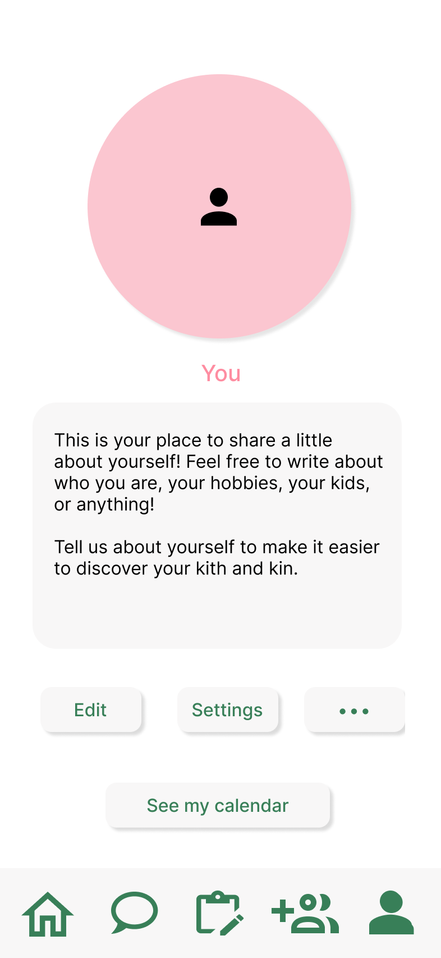
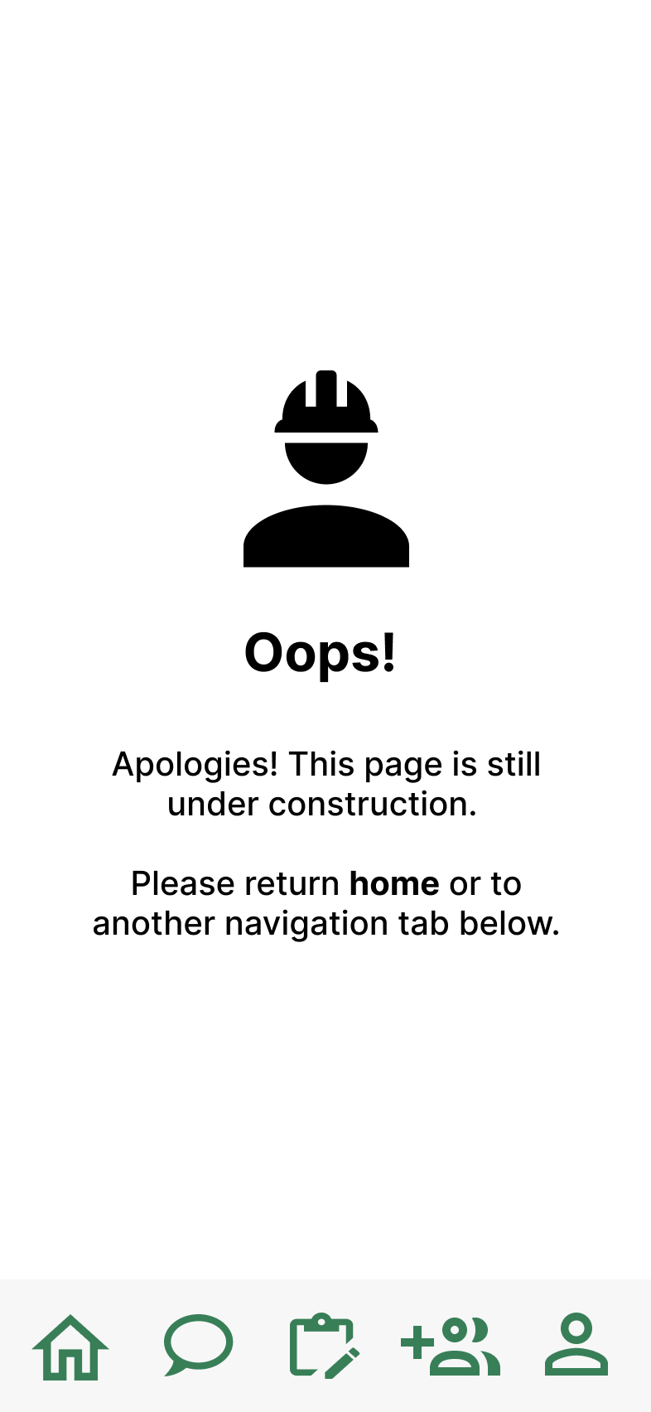
Other Revised UI Screens

